Slide 1
Firearm Laws and Outcomes
Siobhan Harrington
Yue Hu
Andrew Morris
Pritesh Patel
W209.3
Notes:
https://docs.google.com/document/d/11Rs9k_rrTdcq37EwuAXoyahMkR4dIskegcUbBMqkf5U/edit?usp=sharing

Slide 2
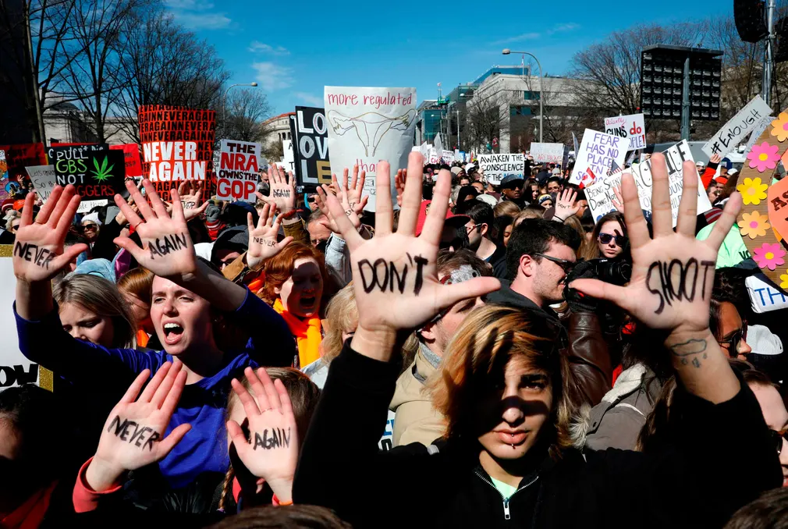
Overall Concept
Firearm violence is a topic of great concern, but it’s unclear what gun laws best address the problem
Firearm legislation is largely at the state level in the USA
Goal: Visualize the correlation between gun violence and gun laws.
Present a clear visual relationship between firearm laws and firearm violence.
Allow exploration for potentially effective strategies to minimize firearm-related violence.
Notes:
Everyday 310 people are shot in the USA. With the rise in gun violence and recent mass shootings, people are demanding their lawmakers to “Do Something”. But what? When certain types of state laws are enacted, do they repeated correlate to a reduced amount of gun violence?

Slide 3

Audience
Audience:
Voters and concerned citizens
Politicians
Potential questions:
What is the state of gun violence in the USA?
Is there a potential correlation between state laws and firearm violence?
Do certain laws have an immediate correlation? Do others take more time?
Tasks for the audience:
Explore gun violence statistics by state
Explore related gun laws by state and type
Explore these dimensions over time

Slide 4

Data Sources
Data used:
CDC WONDER (Wide-ranging OnLine Data for Epidemiologic Research)
Firearm fatality rates. Data is extractable by many views of granularity and time period, starting in 1999.
Statefirearmlaws.org compiled data
State-specific laws. Labeling by category and time periods are also available in this dataset, starting in 1990.
Notes:
Citation:
CDC WONDER: https://wonder.cdc.gov/
State Firearm Laws: http://www.statefirearmlaws.org/resources
NBER: https://www.nber.org/data/vital-statistics-mortality-data-multiple-cause-of-death.html, cause of death codes at https://www.cdc.gov/nchs/data/datalinkage/underlying_and_multiple_cause_of_death_codes.pdf.

Slide 5
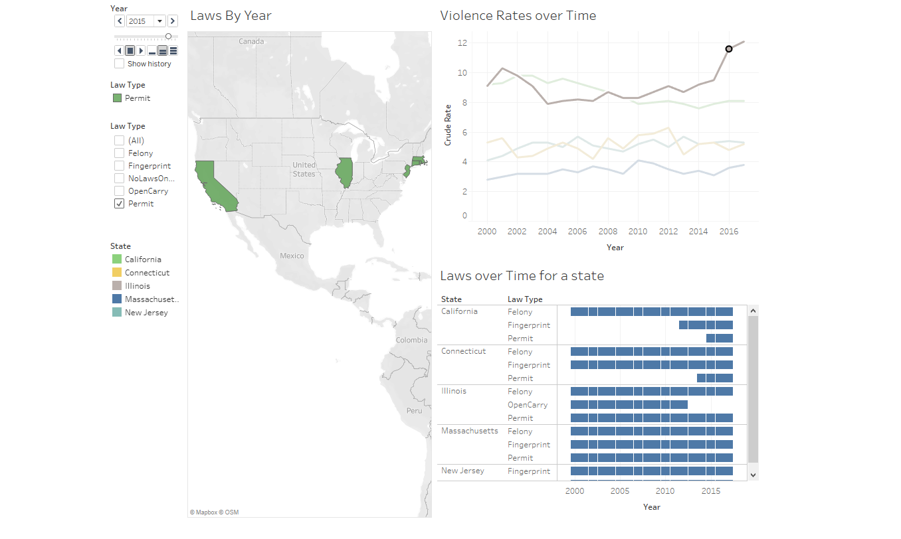
Last time we presented:

Slide 6
Since then
We created a survey to ensure that our data visualization would answer relevant and interesting questions. Here are the highlights of the 100 responses:
95% of respondents are interested in the topic of gun violence prevention legislation
95% of respondents would be interested in understanding correlations between gun laws and gun violence rates
Only 74% of people think that gun laws are currently effective in the USA
62% of respondents think that some laws are more effective than others, while 13% believe that all gun laws are ineffective
Since we have a lot of dimensions, we asked how the data should be broken down. The results were roughly evenly split.
By State
By Time
By Violence Rate
By Law Type
Notes:
SInce then, we have been pretty busy. We created a quick survey and got 100 respondents!

Slide 7
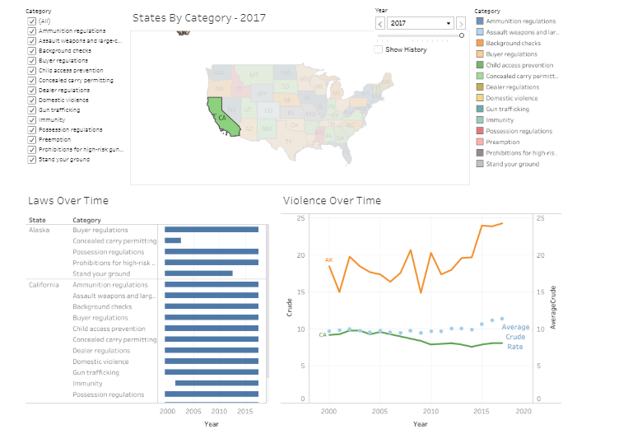
And then
The survey confirmed that our topic was relevant and interesting, so we continued on:
We decided to use Tableau for efficiency and speed given our backgrounds.
We transformed the data and built our version 1.0
We created a usability task list of 10 questions
We ran usability tests on 12 people, providing minimal help while users completed basic tasks
We compiled our feedback and prioritized our enhancements
Notes:
Highlight that we used tableau because it would efficiently accomplish what we wanted to do… it allowed us to focus on
Here’s a screen shot of the view

Slide 8

Guiding Principles for Change Management
We had one week to complete changes
Must Have
Impacted more than one user
Lead the user to incorrect results
Show stopper- user could not complete a task because of this issue
Should Have
Would significantly enhance the user’s overall experience
Level of Effort is low
Could Have
Would somewhat enhance the user’s overall experience
Level of Effort is low
Won’t Have
Only 1 user experienced this issue
Easy “work around” available that could be better communicated
Would require extensive re-work beyond a one week scope
Notes:
Highlight that we used tableau because it would efficiently accomplish what we wanted to do...

Slide 9
MoSCoW
Must Have
Better communication about ability to filter the lower graphs using the map on single or multiple states
“Crude Rate” term is confusing
Hard to read years in two bottom figures (Violence and Laws over Time)
Should/Could Have
Disappearing states and entire map
The right/left page navigation for the filter is slow
“Violence over Time” is too busy to interpret when all states are selected.
Unclear meaning of blue bars in the Law Category section
Won’t Have at This Moment
Unchecking “All” to remove all the law category types was not intuitive
Error occurs when the user changs year quickly with time slider in the map.
With many law categories, the shading blends and becomes difficult to interpret
Notes:
Siobhan

Slide 10
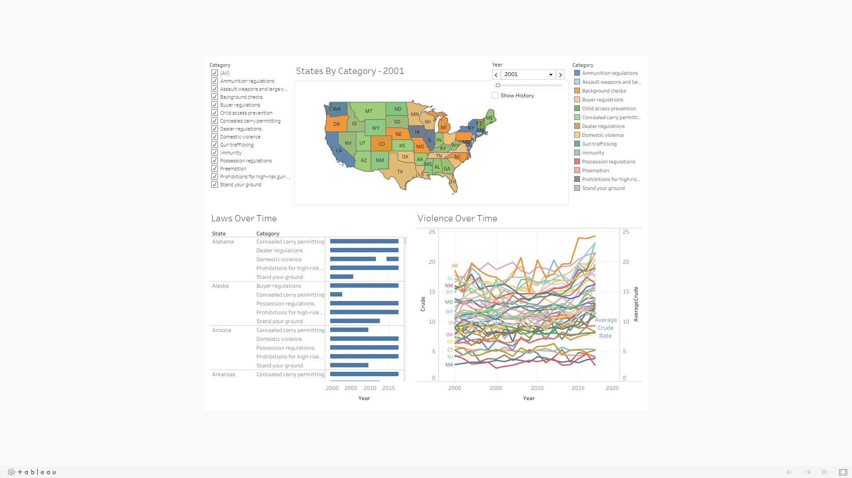
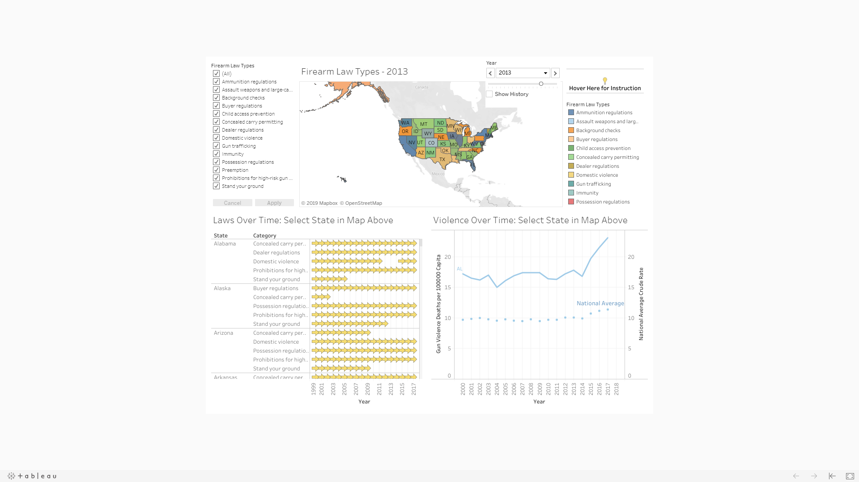
Major Changes (Must Have)
Old Version
Issues
User is unaware that clicking on a state in map will filter two two figures below.
User is unaware how to select more than one state
Solutions
Add “Hover Over Instruction” to guide user to use the data visualization
Add Tips for Using Data Viz and Demo on Website
New Version
Instruction: Hover Here for Instruction
Select Firearm Law Types of Interest on Left Side
Select State on Map to Filter States for All Three Figures Here
Ctrl+Select to Select More than One State for Comparison
Select a Specific Year is faster than Using Time Slider

Slide 11
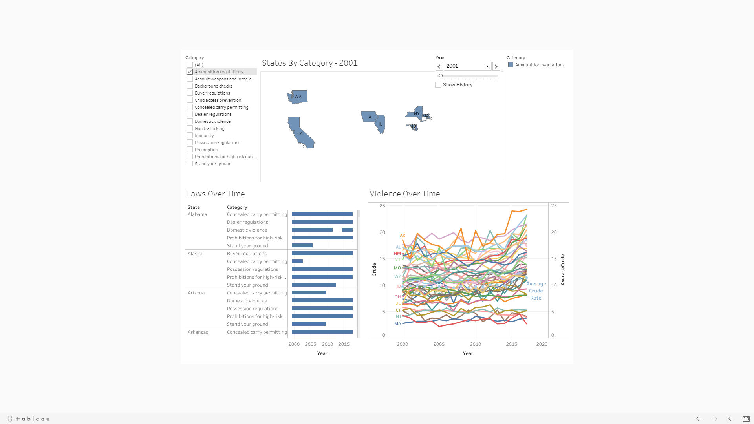
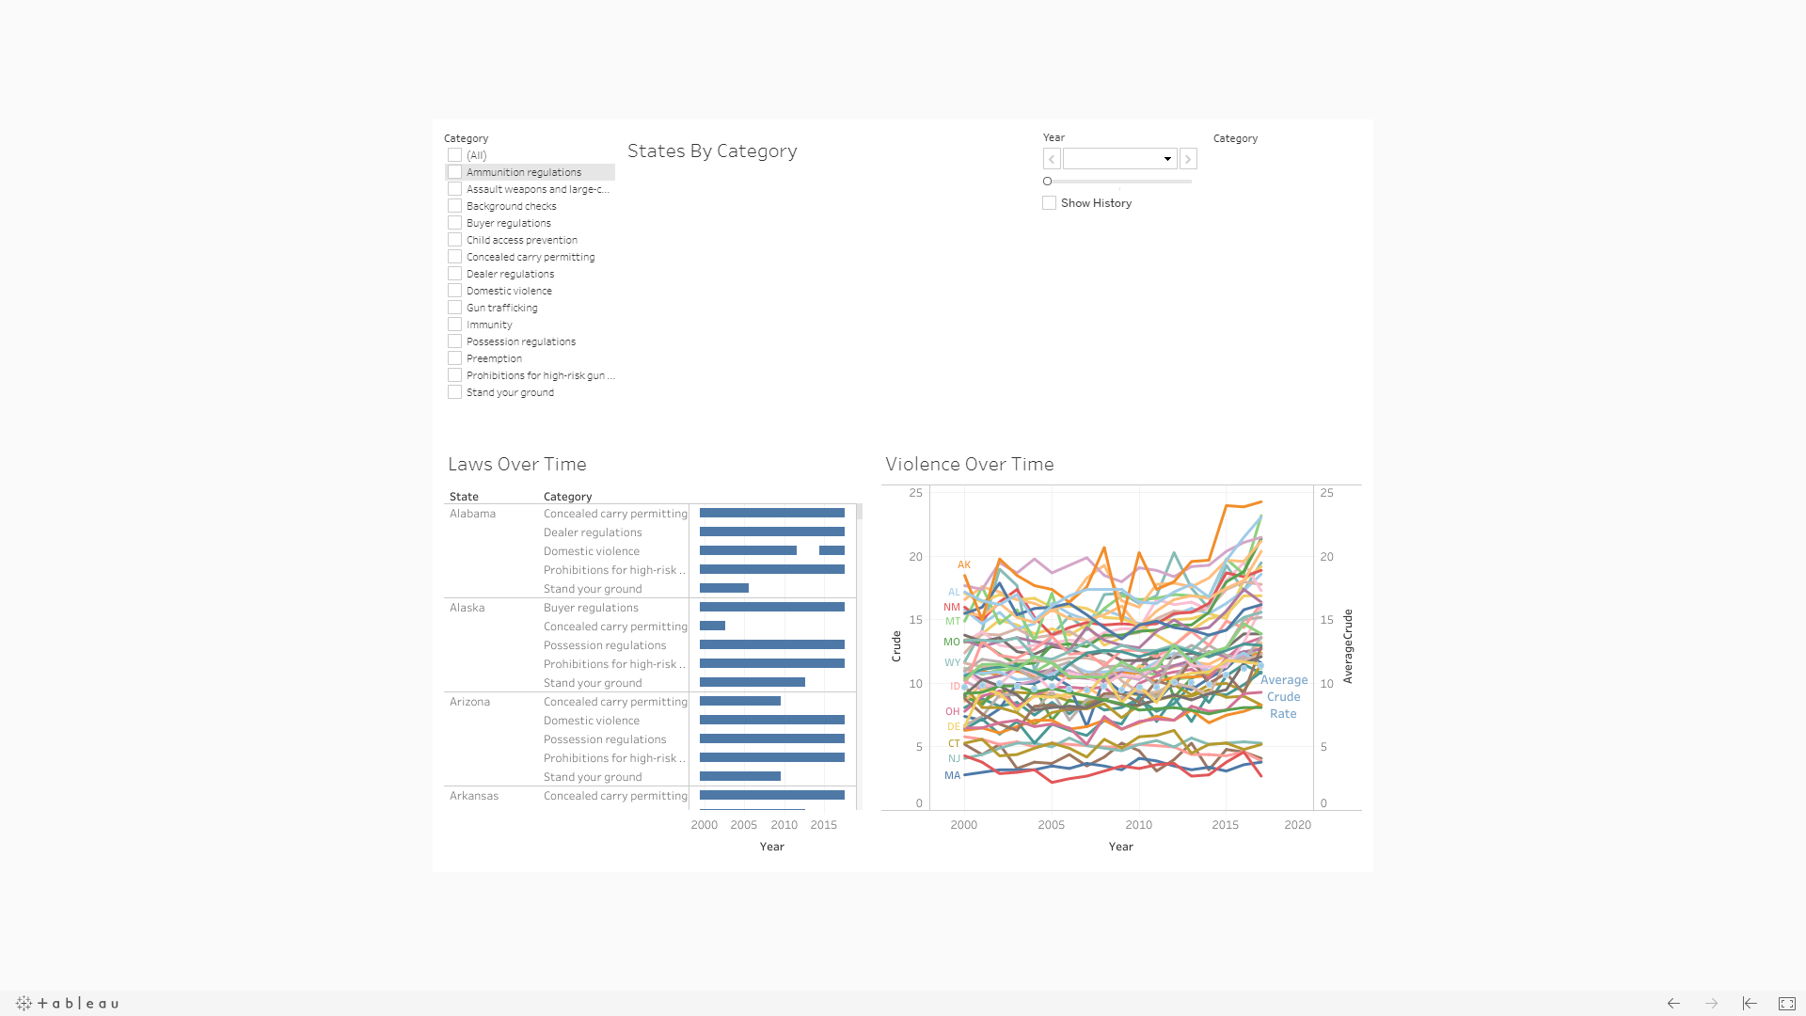
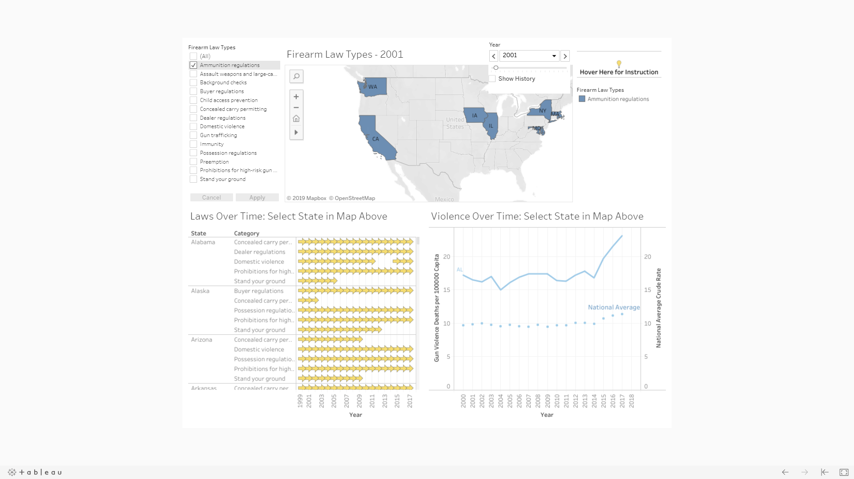
Major Changes (Must Have)
Old Version
New Version
Issues
State Outlines Disappear when the law category not exist in state.
When no law types are selected, whiteboard shows on screen
Solutions
Add board lines and unselect washout in Tableau Map
Whiteboard is typical Tableau functionality when nothing is selected. So “Apply” tab is introduced to avoid whiteboard

Slide 12
Major Changes (Must Have)
Old Version
New Version
Issues
Hard to read years in two bottom figures (Violence and Laws over Time)
User is unaware that clicking on a state in map will filter two two figures below.
Unclear meaning of blue bar (implement/unimplemented)
Solutions
Add Instruction in Title to Guide User to use map to filter states
Fix ticks in Map to show more years
Use Arrow Shape Instead of Blue Bar to represent Period when law is implemented

Slide 13
Major Changes (Must Have)
Old Version
New Version
Issues
Hard to read years
Definition of “Crude” and “Average Crude rate”
Hard to read when all state data is included before filtering
Solutions
Add Instruction in Title to Guide User to use map for filtering
Fix ticks in Map to show more years
Explain Meaning and Basis of Crude Rate in Y axis label
Change “Average Crude Rate” to “National Average”

Slide 14

Quick Demo

Slide 15
Thank you for your time...
Questions?

